Slide 1

CLOUD COMPUTING ARCHITECTURE
Name: Viradiya Ruteeka
Enrollment No. ET22MTCA131

Slide 2


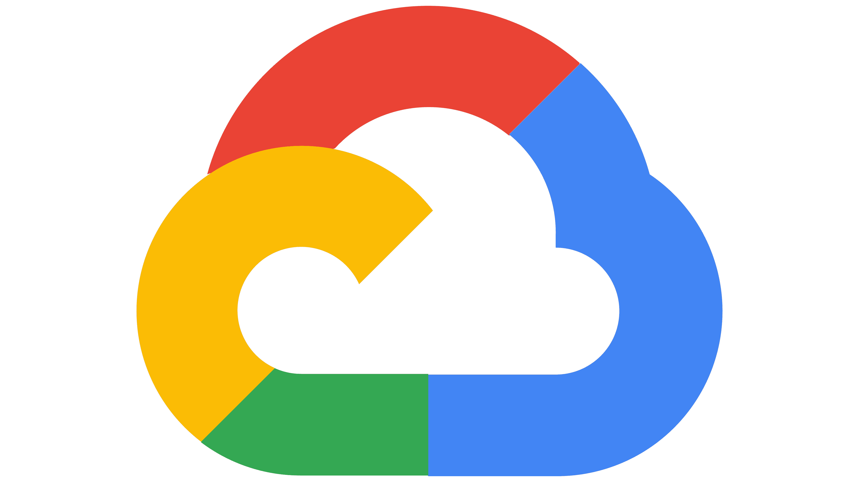
INTRODUCTION
As we know, cloud computing technology is used by both small and large organizations to store the information in cloud and access it from anywhere at anytime using the internet connection.
Cloud computing architecture is a combination of service-oriented architecture and event-driven architecture.
Example: Amazon web service, Microsoft Azure, GCP

Slide 3
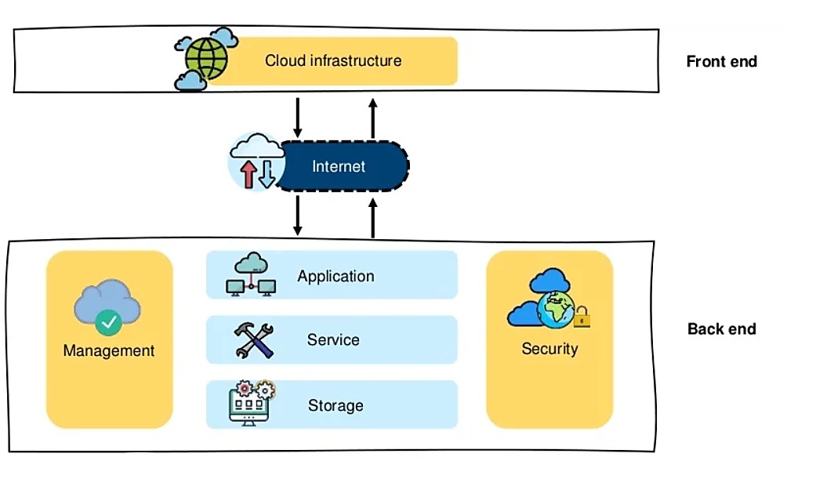
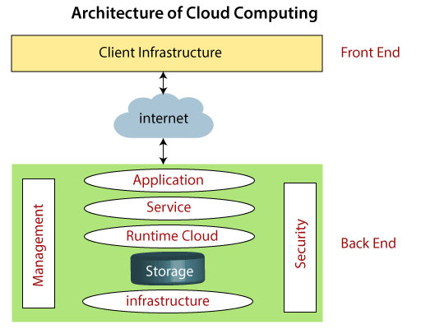
The below diagram shows the architecture of cloud computing -

Slide 4
Cloud computing architecture is divided into the following two parts -
Front End
Back End

Slide 5
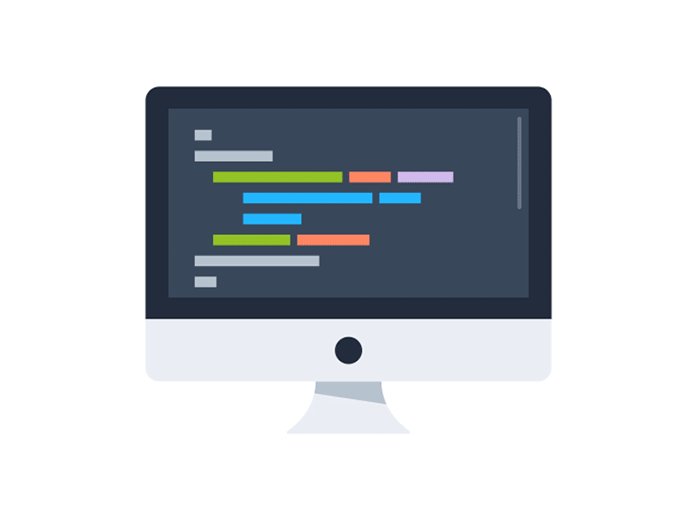
Front End
The front end is used by the client.
It contains client-side interfaces and applications that are required to access the cloud computing platforms.
The front end includes web servers (including Chrome, Firefox, internet explorer, etc.) tablets, and mobile devices.

Slide 6
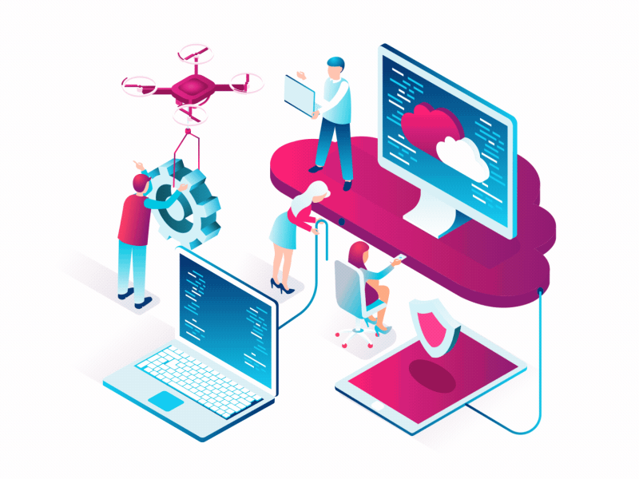
Back End
The back end is used by the service provider.
It manages all the resources that are required to provide cloud computing services.
It includes a huge amount of data storage, security mechanism, virtual machines, deploying models, servers, traffic control mechanisms, etc.

Slide 7
Components of Cloud Computing Architecture
1. Client Infrastructure
Client Infrastructure is a Front end component. It provides GUI (Graphical User Interface) to interact with the cloud.
2. Application
The application may be any software or platform that a client wants to access.

Slide 8
Components of Cloud Computing Architecture
3. Service
A Cloud Services manages that which type of service you access according to the client’s requirement.
Cloud computing offers the following three type of services:
Software as a Service (SaaS) Example: Gmail
Platform as a Service (PaaS) Example: Microsoft Azure
Infrastructure as a Service (IaaS) Example. AWS, Microsoft Azure

Slide 9
Components of Cloud Computing Architecture
4. Runtime Cloud
Runtime Cloud provides the execution and runtime environment to the virtual machines.
5. Storage
Storage is one of the most important components of cloud computing. It provides a huge amount of storage capacity in the cloud to store and manage data.

Slide 10
Components of Cloud Computing Architecture
6. Management
Management is used to manage components such as application, service, runtime cloud, storage, infrastructure, and other security issues in the backend and establish coordination between them.
For Example: High Security, Flexibility, Full time access
7. Security
Security is an in-built back end component of cloud computing. It implements a security mechanism in the back end.

Slide 11
Components of Cloud Computing Architecture
8. Internet
The Internet is medium through which front end and back end can interact and communicate with each other.

Slide 12
THANK YOU

